Slide 1

Quarterly Perspectives: Financial Reporting & Beyond / Q4 2024
January 9, 2025

Slide 2
TO RECEIVE CPE CREDIT
You must respond to at least three of the four polling questions per CPE hour
You must be logged in for a minimum of 50 minutes per every CPE hour in order to receive CPE credit

Slide 3
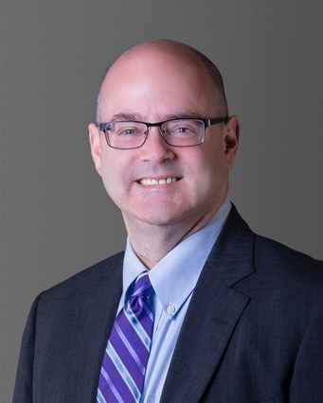
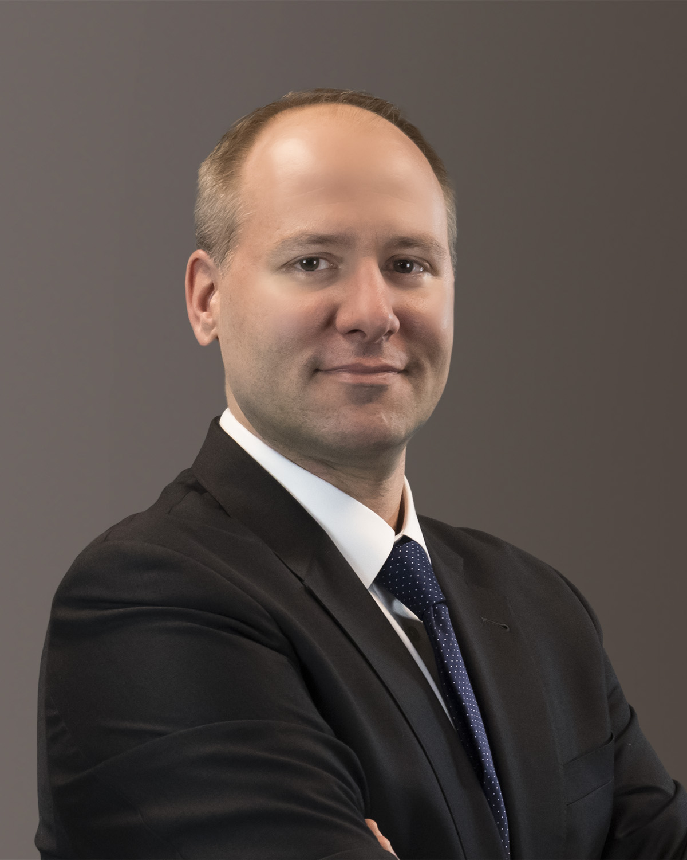
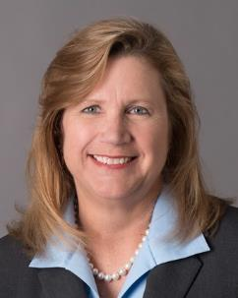
Meet the Presenters From Forvis Mazars A&A Professional Standards Group
Greg Faucette
Jeff Rapaglia
Partner
National Financial Reporting Leader - SEC
Partner
National Director of Public Company Assurance Services
Liz Gantnier
Partner
Regional Assurance Quality Leader

Slide 4
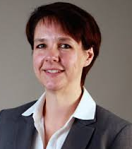
Special Guest
Heather Alley
Partner
National Practice Leader
Washington National Tax

Slide 5
Polling Question
Question 1
What are the chances of fulfilling your most significant New Year’s resolution?
Probable
Reasonably possible
More likely than not
Remote

Slide 6

Looking Back

Slide 7
What Has Caught Our Eye
Hurricanes Helene in September and Milton in October can give rise to accounting issues
Third parties have been “marketing” sale-leaseback transactions
Significant standard setting activities by the PCAOB at the end of the 2024

Slide 8

Here & Now

Slide 9
Polling Question
Question 2
How much of a direct effect do you expect the Washington, DC, political environment and the change in administration to have on your business?
Significant
Moderate
None
There was an election?

Slide 10
A Washington Outlook
What is “critical” about “the first 100 days?”
Primary tax issues facing a new Congress
    Timeline and process
Changes in regulation/regulatory focus and related processes
    Delay in new regulations?
    Rollback of existing regulations?

Slide 11
Polling Question
Question 3
Of the following organizations that traditionally speak at the AICPA’s Conference on Current SEC and PCAOB Matters each year, which most effects you?
SEC
PCAOB
FASB
None of the above (or does not apply)

Slide 12
2024 AICPA & CIMA Conference on Current SEC and PCAOB Matters
Major Observations and Themes
General “political” environment of the regulatory ecosystem
SEC – Paul Munter, Chief Accountant
    Accountants serve the public interest
    Importance of the cash flow statement
PCAOB – Erica Williams, Board Chair
    Progress in revisiting auditing standards
    Increased transparency to stakeholders
FASB – Rich Jones, Board Chair
    FASB’s consideration of comments on projects
    Upcoming agenda consultation for future standard setting

Slide 13
2024 AICPA & CIMA Conference on Current SEC and PCAOB Matters
Selected Technical “Nuggets”
Use of non-GAAP measures in ASU 2023-07 segment reporting improvements
Slippage in compliance with non-GAAP measure requirements in general
“Checkbox” reporting on the cover of a Form 10-K under the SEC’s clawback rules
General commentary on MD&A disclosures
Debt and equity classification issues permeated various sessions at the conference

Slide 14
PCAOB Select New Standards
  New auditing standards effective within 18 months
      General Responsibilities of the Auditor in Conducting an Audit
      Use of Other Auditors
      Confirmations
      Designing and Performing Audit Procedures that Involve Technology-Assisted Analysis of Information in Electronic Form
  Quality Control 1000 - New quality control standard for audit firms

Slide 15
PCAOB Standard Setting Process
  Process for standards finalized by the PCAOB to be approved by the SEC to become effective
  PCAOB standards awaiting SEC approval
      Firm and Engagement Metrics
      Firm Reporting
  Auditing - Non-Compliance with Laws and Regulations (NOCLAR) status?

Slide 16

Conversations You Should Be Having

Slide 17
Polling Question
Question 4
Would you like to be contacted by a Forvis Mazars professional to discuss one of the following topics?
Tax and regulatory developments in Washington, DC
SEC reporting issues
FASB standard adoption
Not at this time, thank you.

Slide 18
What is On the Horizon
Don’t sell short the effort to adopt some of the FASB’s more recent standards, including ASU 2023-07 on segments and ASU 2024-03 on disaggregation of income statement expenses
Focus on internal control over financial reporting by all entities, including continued “recovery” from the effects of a remote operating environment
Accounting complexities in transactional and financing activities for entities involved with private equity groups (“PEGs”)

Slide 19
forvismazars.us/forsights
Selected FORsights™
From the Hill
New FASB Guidance on Induced Conversions
GASB 2025 – The Year Ahead
SEC Regulatory Outlook 2025 - Registrants
Accounting Method Planning in Anticipation of Tax Law Changes
FORsights – Tax & Advisory Articles, Resources, Podcasts, Webinars, & News
Our thought leadership program focused on articles, webinars, podcasts, & videos aimed at helping our clients navigate the financial landscape. FORsights spans across key topics in assurance, tax, & consulting that reflects our industry intelligence, technical knowledge, & our forward vision to keep clients informed & on top of issues that affect them.

Slide 20


CPE CREDIT
CPE credit may be awarded upon verification of participant attendance
For questions, concerns, or comments regarding CPE credit, please email FORVIS at cpecompliance@us.forvismazars.com
Forvis Mazars, LLP is registered with the National Association of State Boards of Accountancy (NASBA) as a sponsor of continuing professional education on the National Registry of CPE Sponsors. State boards of accountancy have final authority on the acceptance of individual courses for CPE credit. Complaints regarding registered sponsors may be submitted to the National Registry of CPE Sponsors through its website: www.nasbaregistry.org

Slide 21
Thank you!
Please join us again on April 17, 2025, for the first installment of the 2025 Quarterly Perspective webinar series, as well as the following dates for the entire 2025 series:
July 17, 2025
October 16, 2025
January 8, 2026
Don’t miss our next invitation, subscribe to FORsights today!
The information set forth in this presentation contains the analysis and conclusions of the author(s) based upon his/her/their research and analysis of industry information and legal authorities. Such analysis and conclusions should not be deemed opinions or conclusions by Forvis Mazars or the author(s) as to any individual situation as situations are fact-specific. The reader should perform their own analysis and form their own conclusions regarding any specific situation. Further, the author(s)’ conclusions may be revised without notice with or without changes in industry information and legal authorities.
2025 Forvis Mazars, LLP. All rights reserved.

